Slide 1

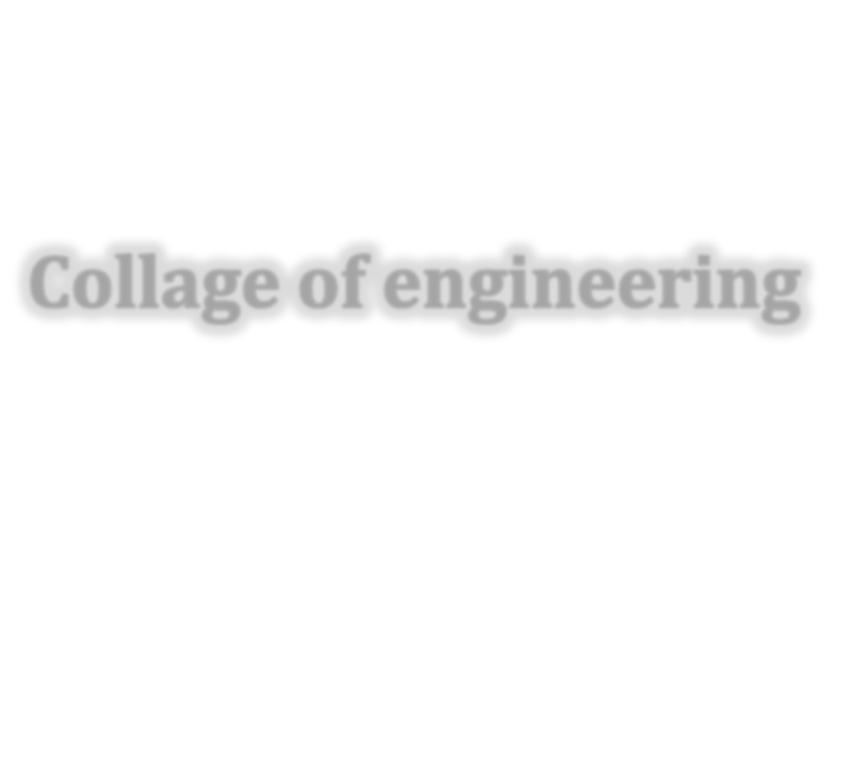










PRESENTED BY
Abbas Al-Bawee
Manufacturing processes involving polymers
1

Slide 6
